Slide 1
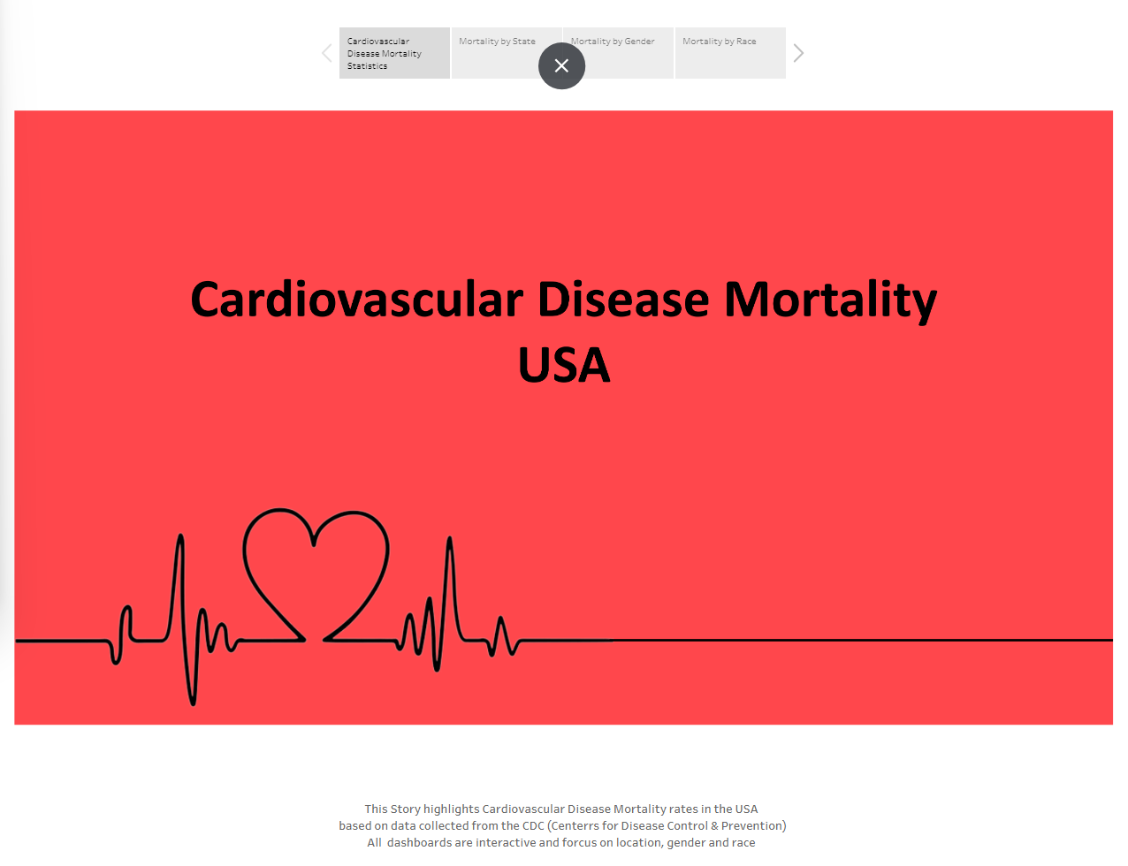

Slide 2
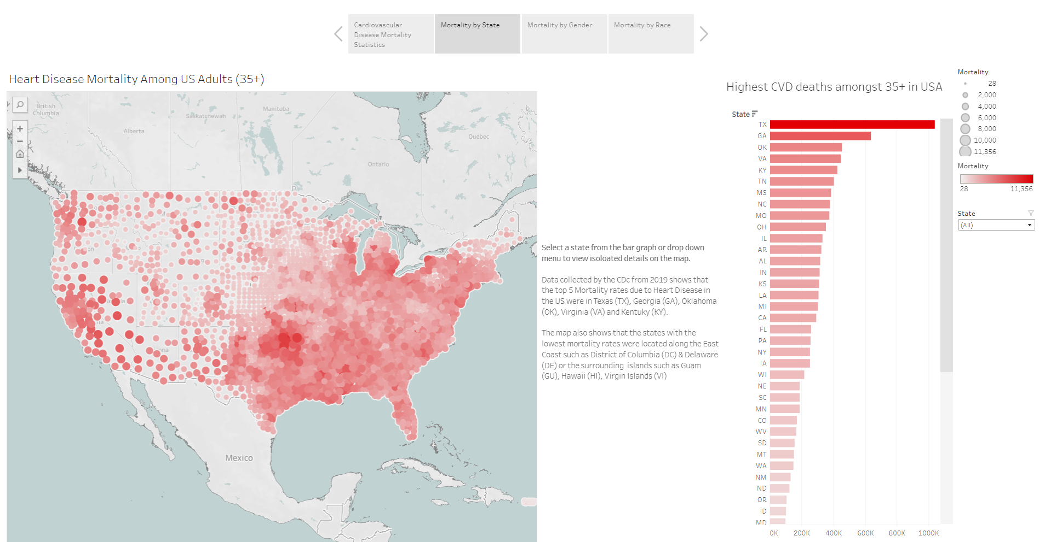

Slide 3
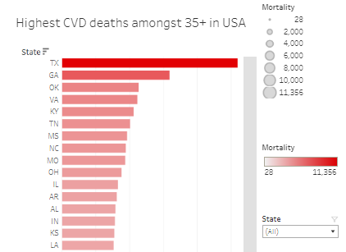
Select a state from the bar graph or drop down menu to view isoloated details on the map.
Data collected by the CDc from 2019 shows that the top 5 Mortality rates due to Heart Disease in the US were in Texas (TX), Georgia (GA), Oklahoma (OK), Virginia (VA) and Kentuky (KY).
The map also shows that the states with the lowest mortality rates were located along the East Coast such as District of Columbia (DC) & Delaware (DE) or the surrounding islands such as Guam (GU), Hawaii (HI), Virgin Islands (VI)

Slide 4

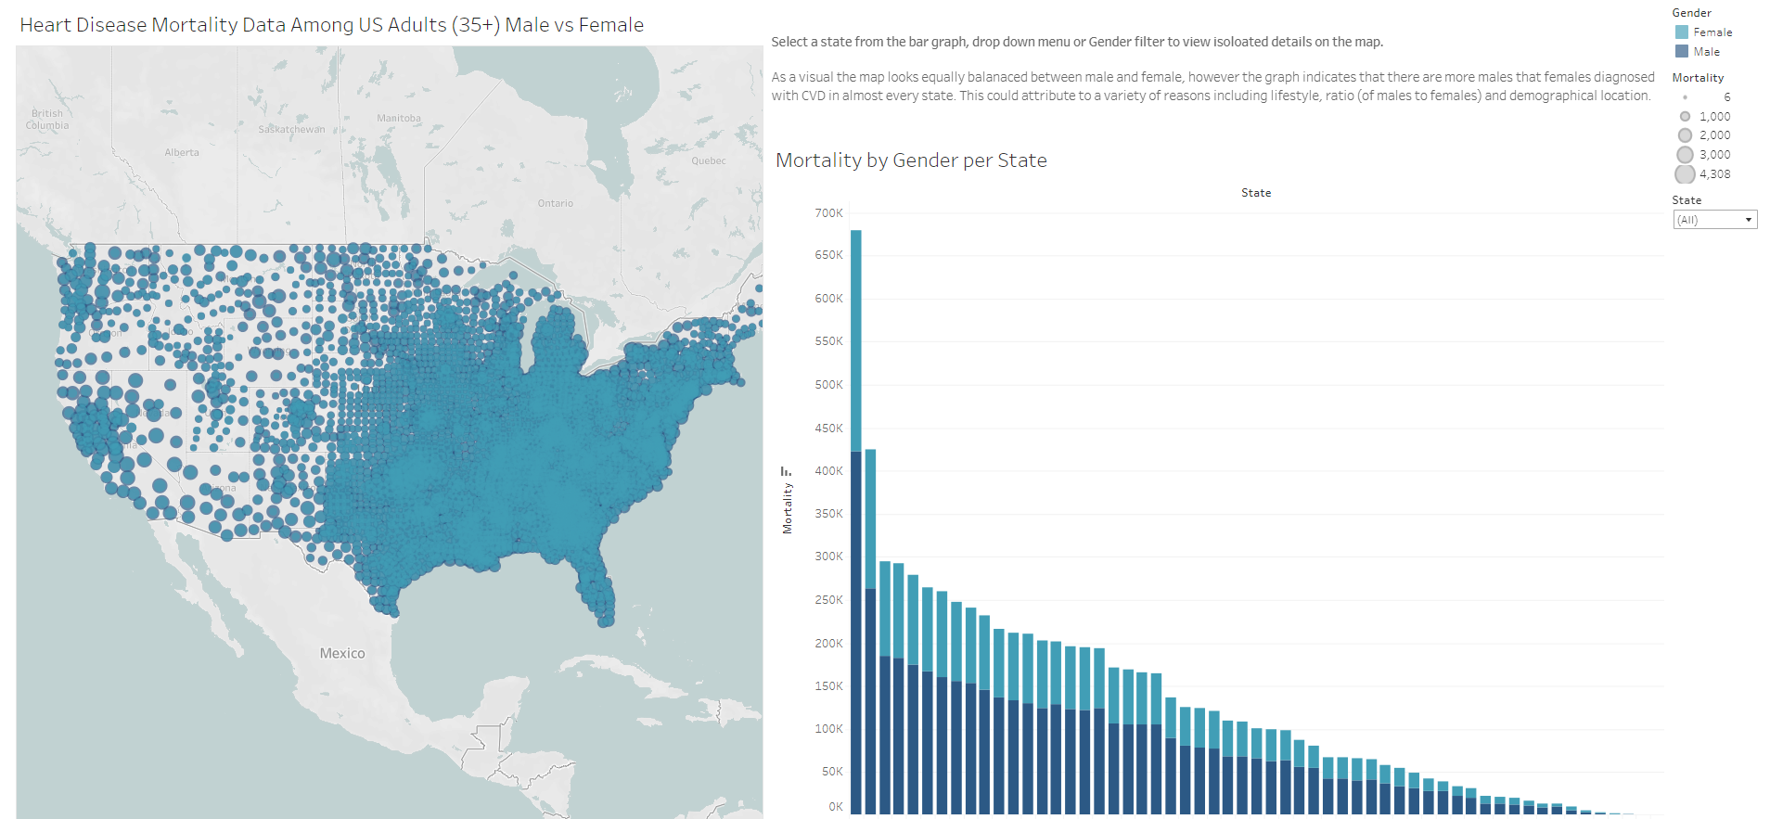

Slide 5
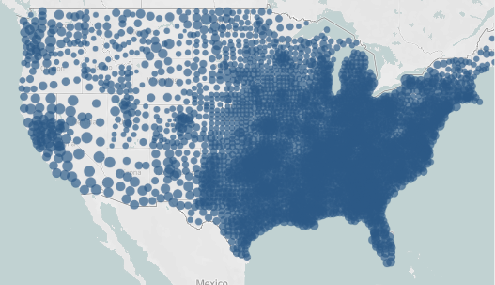

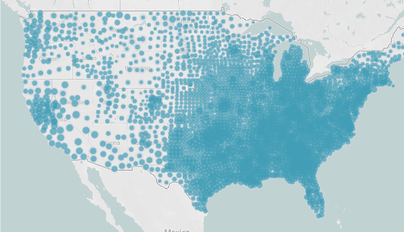
Select a state from the bar graph, drop down menu or Gender filter to view isolated details on the map.
As a visual the map looks equally balanced between male and female, however the graph indicates that there are more males that females diagnosed with CVD in almost every state. This could attribute to a variety of reasons including lifestyle, ratio (of males to females) and demographical location.

Slide 6
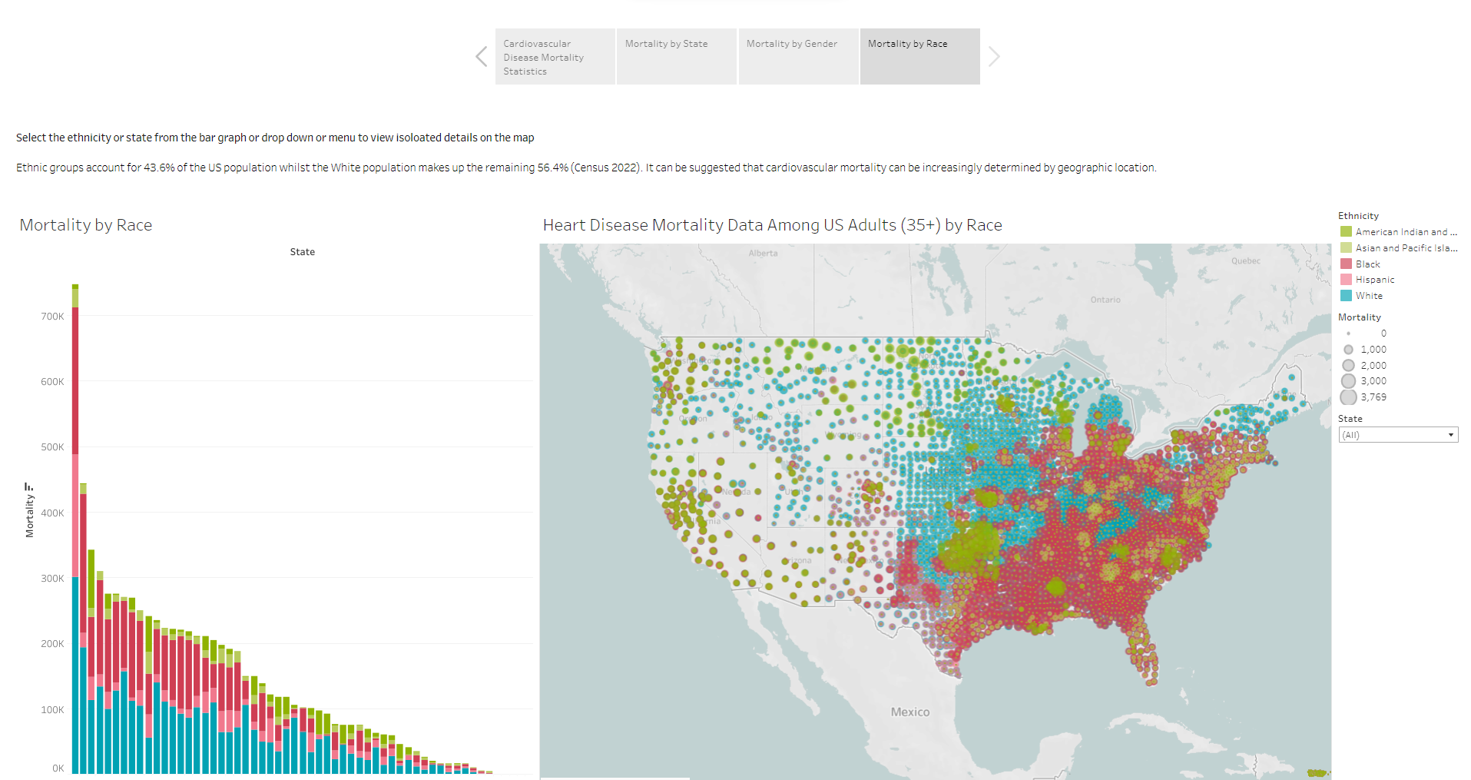

Slide 7
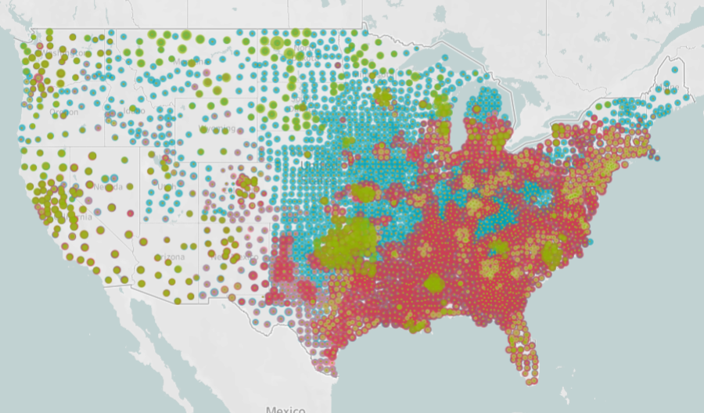

Select the ethnicity or state from the bar graph or drop down or menu to view isolated details on the map
Ethnic groups account for 43.6% of the US population whilst the White population makes up the remaining 56.4% (Census 2022). It can be suggested that cardiovascular mortality can be increasingly determined by geographic location.

Slide 8
